Slide 1
Quick Shopping
Power by：
Qian Gao Zhongrui Yu Didi Zhu

Slide 2
CONCENTS
Why is it
What is it
How is it

Slide 3
01
WHY IS IT
1

Slide 4


Traditional shopping method
Troublesome operation
consumers need to browse information on
different websites
Waste time
The amount of goods is too large on the page,
costs the consumer a lot of time to pick the goods.
2

Slide 5

Our web application
No need to switch to pages of different e-commerce platforms
Show goods information in
the form of a barrage,
quick browsing and selection
Simple operation
Quick shopping
·
Comprehensive comparison
Fun Experience
Climb information
from major e-commerce
platforms to compare
goods more comprehensively
Similar to the lottery
operation, increasing
the fun of shopping
3

Slide 6
02
WHAT IS IT
4

Slide 7

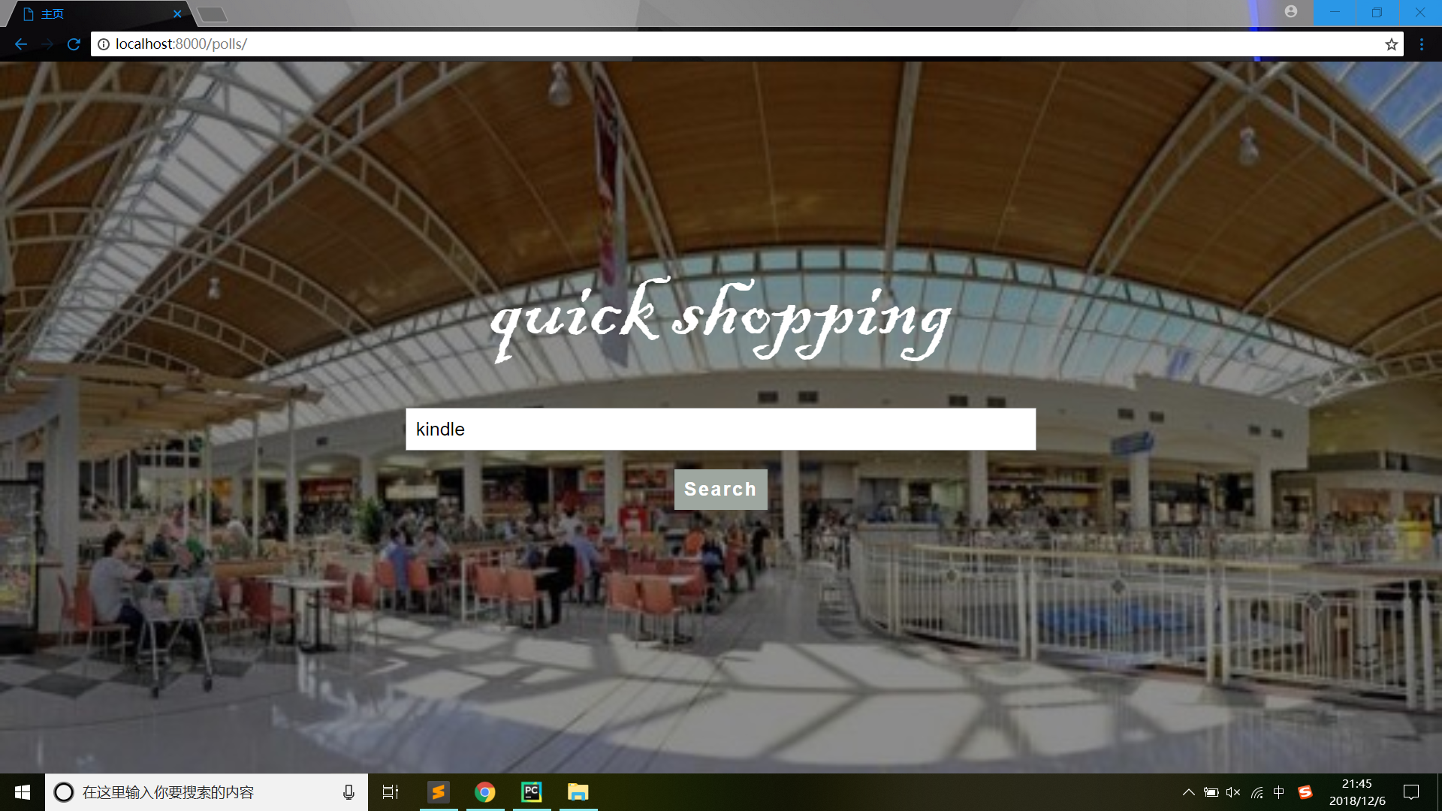
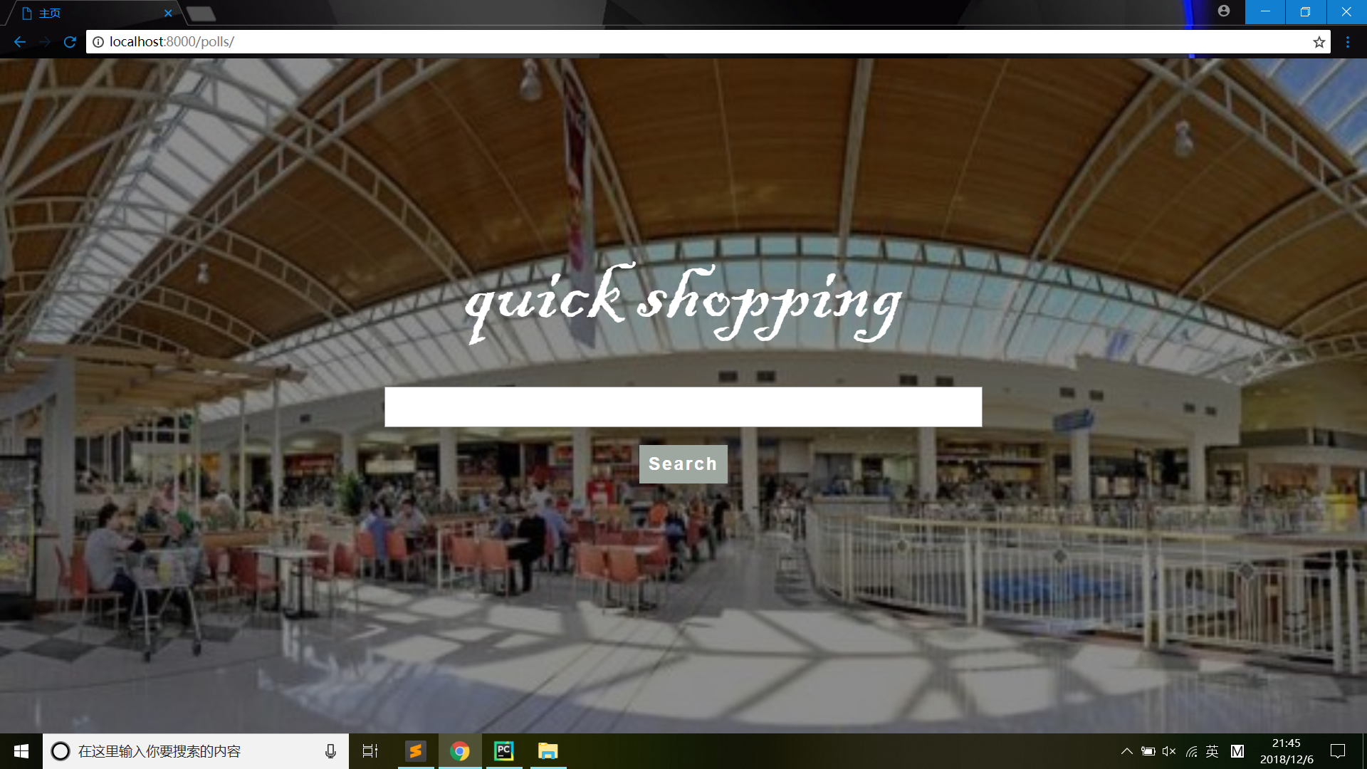

WHAT IS IT?
For users, if you want to buy some things with reliable quality in a short time, all you need to do is just to input the name of the goods.
INPUT “kindle”
5

Slide 8
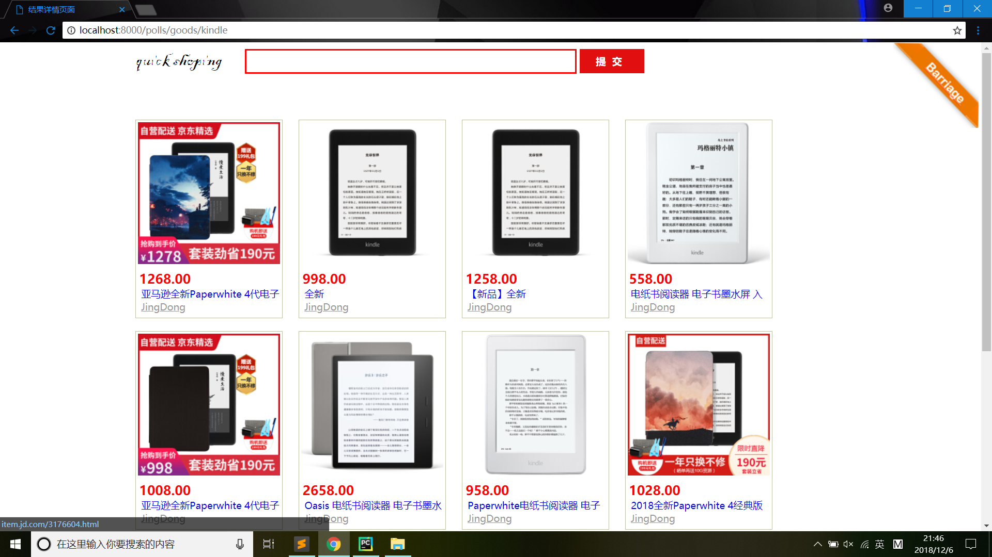
WHAT IS IT?
Then goods from different e commerce giants will be presented.
You can click the corresponding picture to see detailed information.
6

Slide 9
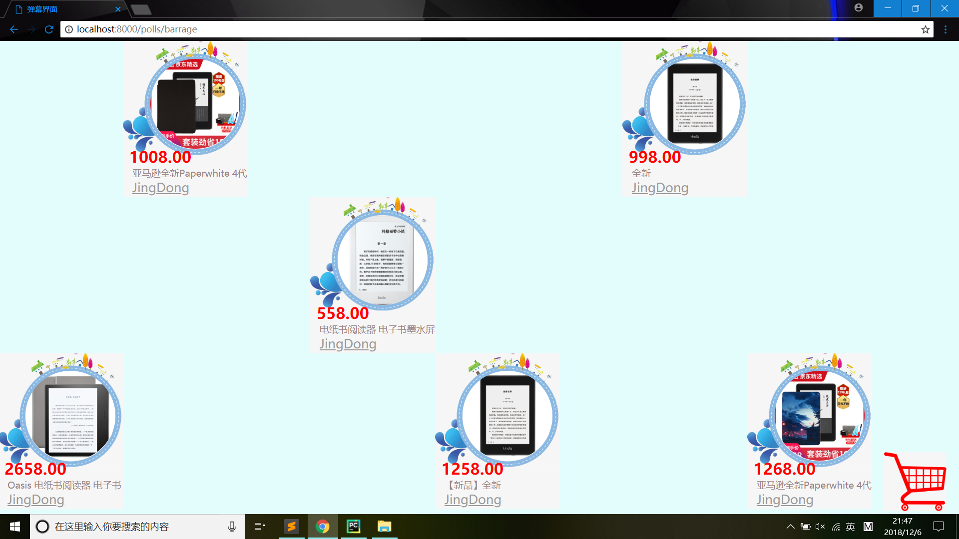
WHAT IS IT?
However, simply browsing the website can be boring and time wasting.
We develop a small scene with moving blocks on which attached goods’ information.
1
1
7

Slide 10
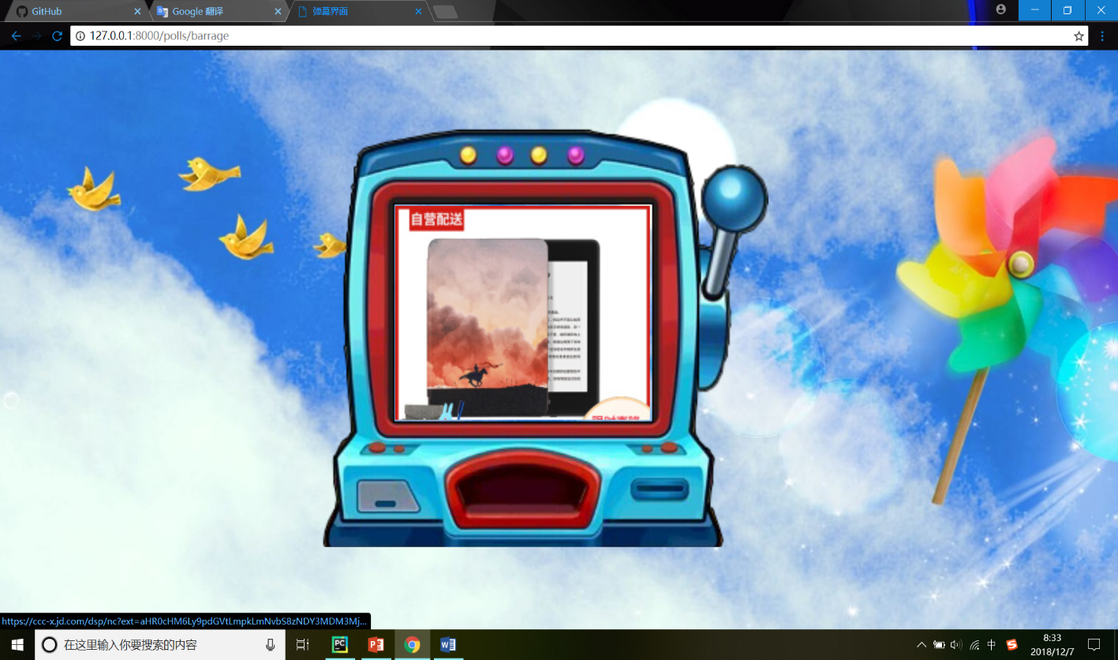
WHAT IS IT?
If at last you have no idea which to buy, you still have one more way ------random!
A small game with goods’ picture will randomly choose one goods, if you don’t want waste time any more,that’s it.
8

Slide 11
03
HOW IS IT
9

Slide 12


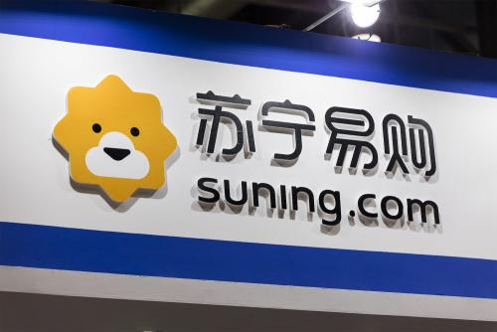
Process
Input a keyword
Get small amount data first
Render the template and display part result
Start three threads work background to get more information
Get data and store data use Mysql database
10

Slide 13
Django
M
V
T
MODLES
Define data structure
Connect Mysql
VIEWS
get information
Logic part
present
TEMPLATE
Html
design
how to present
11

Slide 14
04
IMPROVEMENTS
12

Slide 15
IMPROVEMENTS
Efficiency
Improve the efficiency of web crawlers
Animation
Add more details to the animation
Filter Function
Add the function of Filter according to the price or comments
13

Slide 16
Thanks
Power by：
Qian Gao Zhongrui Yu Didi Zhu

